Slide 1
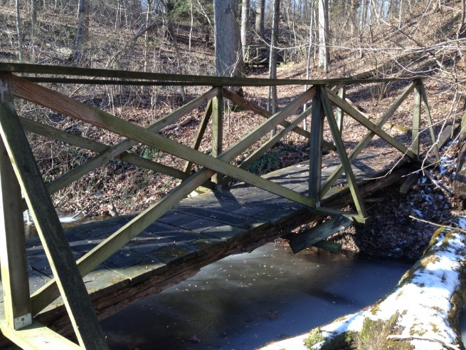
I WANT YOU
FOR ZACH’s EAGLE PROJECT
March 21-22
9 am – 4:30 pm
IWLA Chapter House, 18301 Waring Station Rd, Germantown, MD 20874
We plan to demolish and rebuild one of the three footbridges that leads from the IWLA chapter house to the lake. Help make the walking trail safer and allow people to enjoy nature.
Lunch and Snacks provided
Earn SSL Hours
You don’t need to stay the whole time.
Stop by any time, even for an hour!
What to Wear: Working clothes like jeans and a long sleeved shirt, gloves, and closed toe shoes like sneakers or boots. No flip flops
What to Bring: Hammer, crowbar
Questions: call me at 240-751-7714 or email at zott1620@gmail.com

